Slide 1
Geospecial

Slide 2
The Problem
Users register important locations to be notified about
Users receive notifications when atrocious events occur in those locations

Slide 3
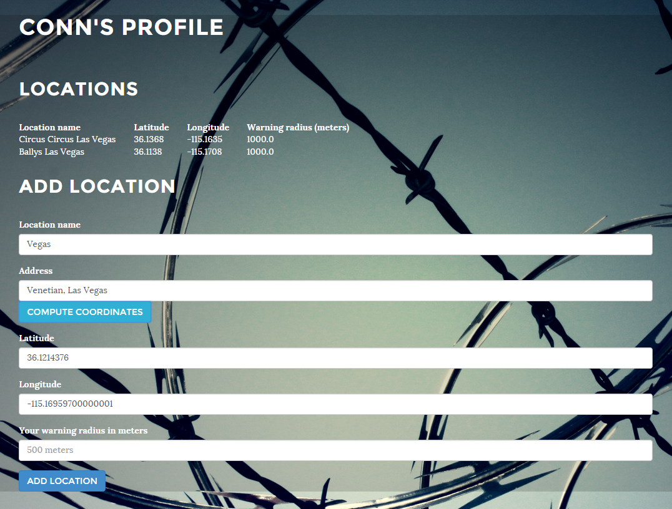
Profile
Users can create profiles
Users can add additional locations to watch
Each location can have a different notification radius associated with them

Slide 4
Notifications
Get alert when a new atrocity occurs in a registered location
Get alert when your current location intersects an existing atrocity

Slide 5
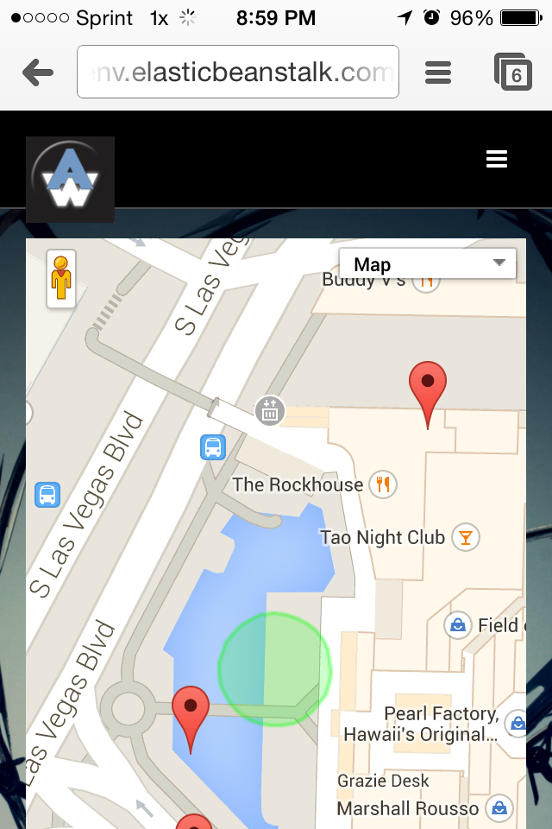
New Location
The Track Me page sends the user’s location and displays events on a map
Once the user enters the vicinity of a past event the user is notified through SMS

Slide 6


Slide 7
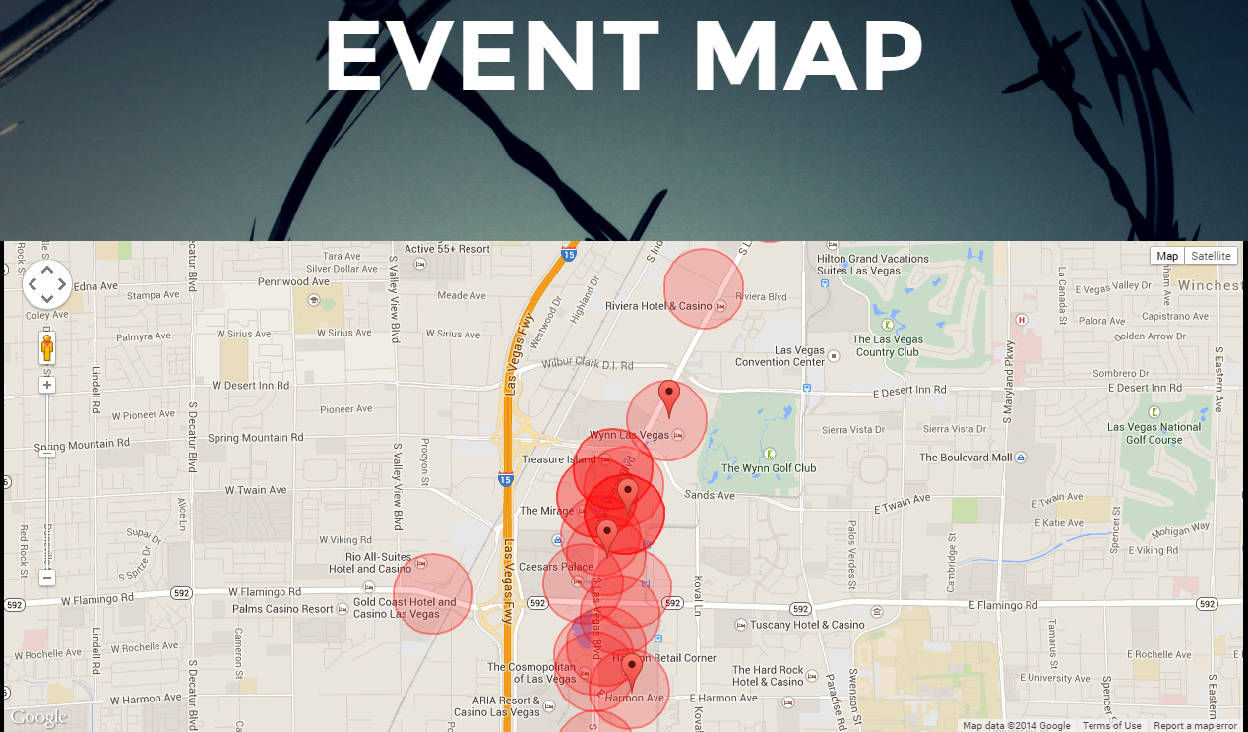
New Events
New events triggers a run through of old locations
An admin page shows new events as they occur on a map to help visualize events and locations

Slide 8
Amazon Infrastructure
App is hosted on Elastic Beanstalk
Autoscaling group to help app scale
App uses a Postgres/PostGIS RDS backend
App attempted to use SES for email notifications

Slide 9
Future
Scalability
Built for scalability using EB autoscaling and RDS
Notifications
Multiple notification mechanisms such as text, email, and IoT
Smarter triggers
Polygon bounding boxes, date based event queries, and complex rules system
Simple queue service

